Slide 1
IETF Hackathon
IETF 94, October 31 – November 1,
Yokohama, Japan

Slide 2

Goals
Running Code (RFC 6982)
Open Source
Speed and Relevance of Standards
Collaborate and Learn
Have Fun
Cookies!!!

Slide 3
Note Well
Any submission to the IETF intended by the Contributor for publication as all or part of an IETF Internet-Draft or RFC and any statement made within the context of an IETF activity is considered an "IETF Contribution". Such statements include oral statements in IETF sessions, as well as written and electronic communications made at any time or place, which are addressed to:
The IETF plenary session
The IESG, or any member thereof on behalf of the IESG
Any IETF mailing list, including the IETF list itself, any working group or design team list, or any other list functioning under IETF auspices
Any IETF working group or portion thereof
Any Birds of a Feather (BOF) session
The IAB or any member thereof on behalf of the IAB
The RFC Editor or the Internet-Drafts function
All IETF Contributions are subject to the rules of RFC 5378 and RFC 3979 (updated by RFC 4879).
Statements made outside of an IETF session, mailing list or other function, that are clearly not intended to be input to an IETF activity, group or function, are not IETF Contributions in the context of this notice. Please consult RFC 5378 and RFC 3979 for details.
A participant in any IETF activity is deemed to accept all IETF rules of process, as documented in Best Current Practices RFCs and IESG Statements.
A participant in any IETF activity acknowledges that written, audio and video records of meetings may be made and may be available to the public.

Slide 4
IPR and Code Contribution Guideline
Hackathon participants free to work on any code
Rules regarding that code are what each participant's organization and/or open source project says they are
The code itself is NOT an IETF contribution
Discussions, presentations, and demos done as part of the hackathon are the same type of IETF contributions as those made in working groups; therefore, the usual IETF copyright and/or IPR disclosure rules apply

Slide 5
Technologies
DHCPv4o6 - Dynamic Host Configuration Protocol IPv4 over IPv6
DNS / DNSSEC / DANE / DNS-over (D)TLS
HOMENET – DNS64, NAT64, DNCP/HNCP, OpenWrt
IBNEMO – Intent Based Network Modeling
ICE – Interactive Connectivity Establishment
MPTCP - Multi-Path TCP
NETCONF/YANG, I2RS, OpenDaylight
NETVC - Internet Video Codec and Daala, Thor
RIOT - OS for internet of things
SFC (Service Function Chaining)

Slide 6
Collaborate on Code https://github.com/eckelcu/ietf-hackathon
Git/GitHub commonly used for open source projects
Getting started:
Install Git on laptop https://help.github.com/articles/set-up-git/
Join Hackathon repo https://github.com/eckelcu/ietf-hackathon
Working on existing project, or add a new one, by forking https://help.github.com/articles/fork-a-repo/
“Follow” team members and “watch” project(s) https://help.github.com/articles/be-social/
More info: http://gitref.org

Slide 7
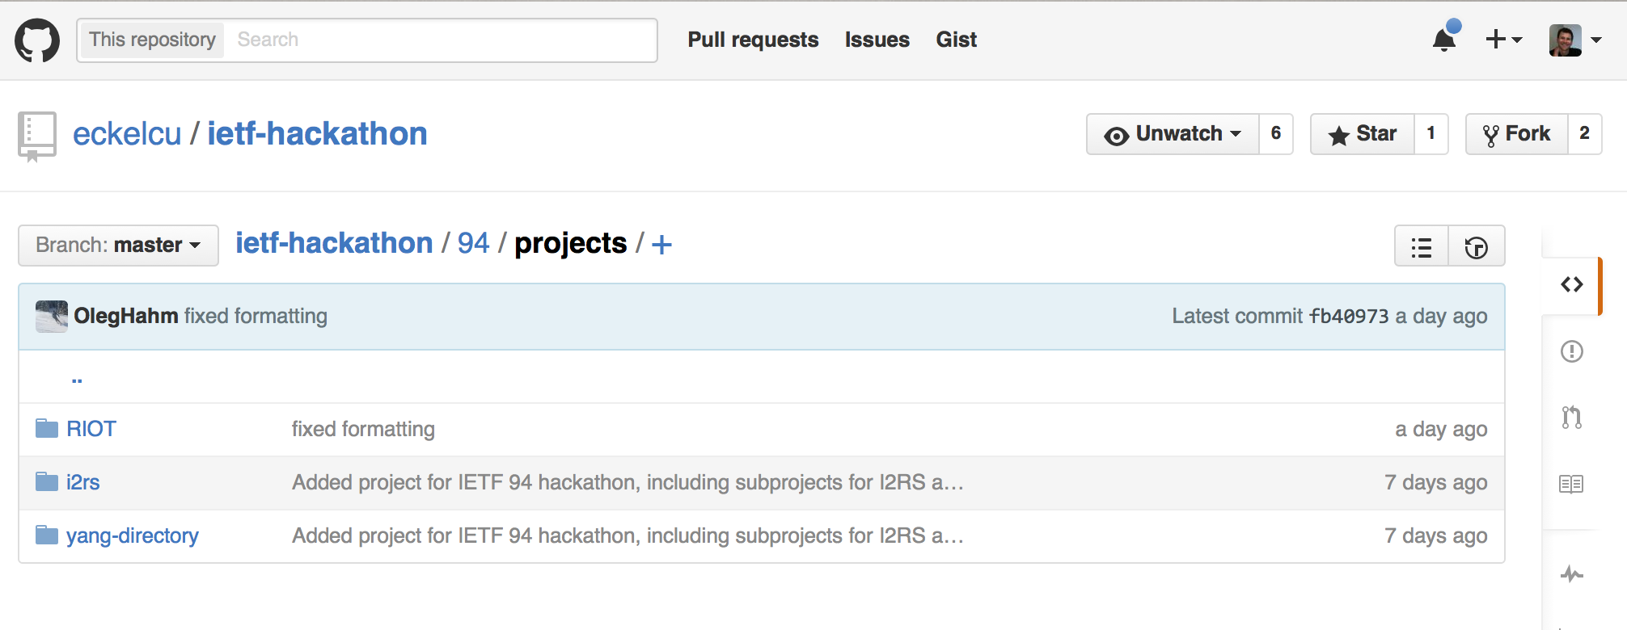
https://github.com/eckelcu/ietf-hackathon/94
./presentations/.
./projects/

Slide 8
Agenda - Saturday
09:00: Room opens - Pastries and coffee provided
09:30: Hackathon kickoff - Intro to all technologies by champions, form teams
12:30: Lunch provided
15:30: Afternoon break - Snacks provided
18:30: Progress check and sharing
19:00: Dinner provided
22:00: Room closes and is locked

Slide 9
Agenda - Sunday
09:00: Room opens - Pastries and coffee provided
12:30: Lunch provided
13:30: Hacking stops, prepare brief presentation of project
14:00: Project presentation to other participants and judges
15:00: Recap and suggestions for improvements
15:30: Awards presented, prizes given
16:00: Hackathon ends

Slide 10
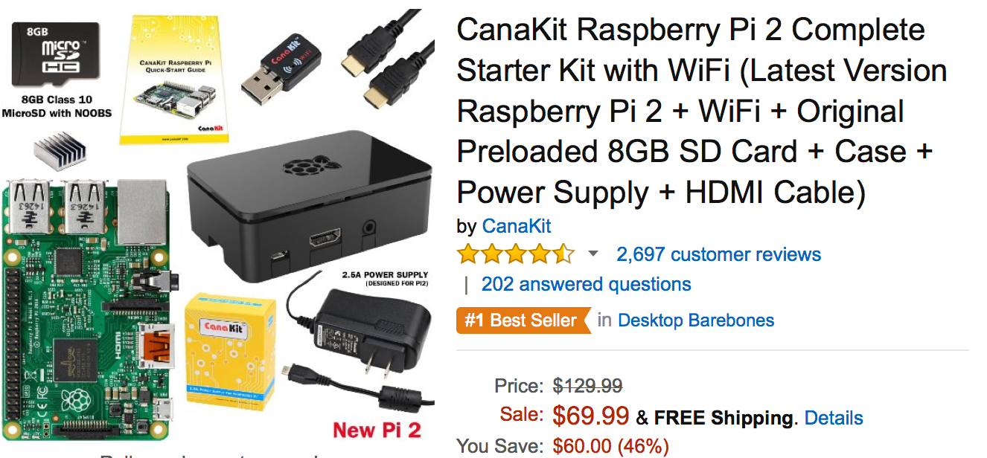
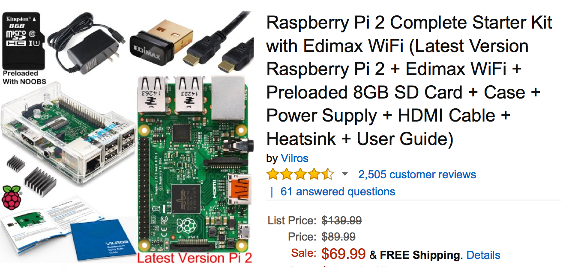
P r i z e s

Slide 11
Judging Criteria
Advance pace and relevance of IETF standards
Bring speed and collaborative spirit of open source software into the IETF
Flush out ideas, feed into WG session
Produce sample code/reference implementations
Create useful utilities
Attract developers, young people to IETF
There’s cool shit at IETF
#IETFhackathon, #IETF94

Slide 12
Bits-N-Bites
Table for Hackathon Projects
Show off what you did
Thursday, 19:00 – 21:00
Intercontinental Ballroom
Food and drinks provided

Slide 13
#IETFhackathon Photo Contest
Best IETF Hackathon Photo
Post to Twitter
#IETFhackathon
#IETF94

Slide 14
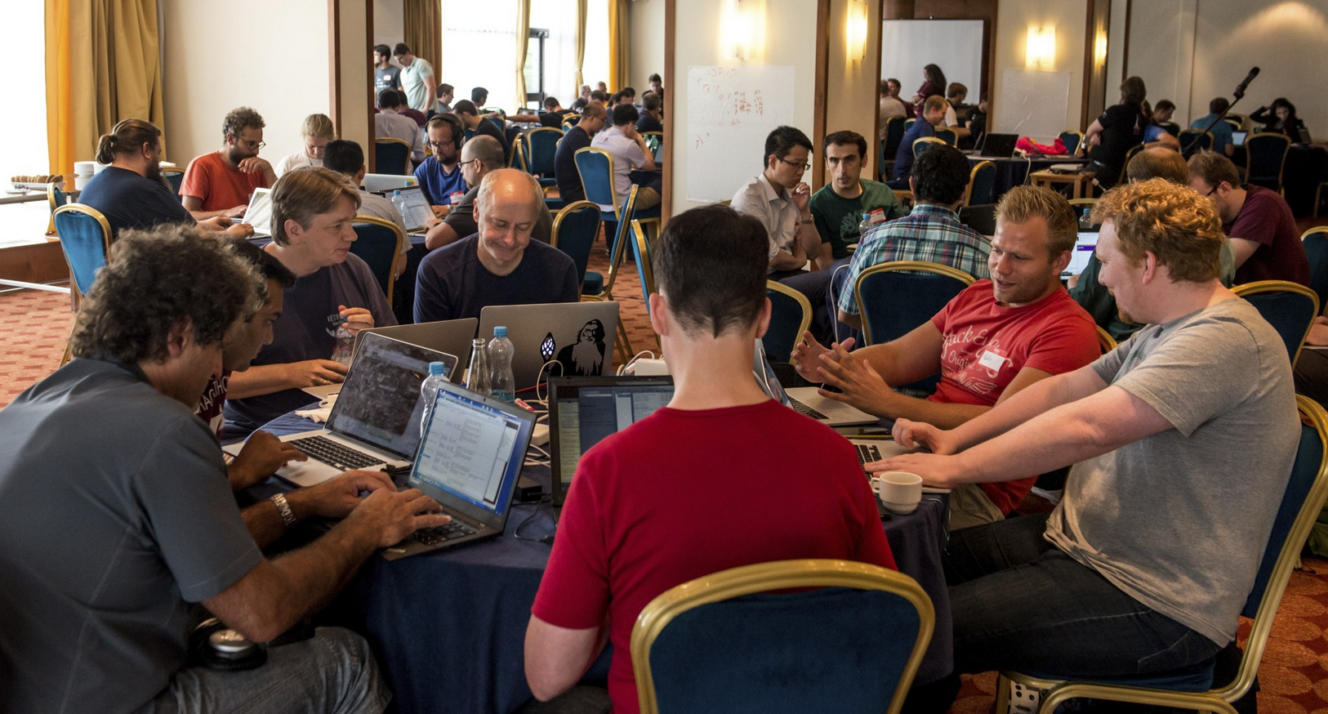
Let’s Get Hacking!

